Slide 1
Understanding Multiplication

Slide 2
Multiplication is Repeated Addition
Multiplication is adding the same number again and again.
Example: 3 x 4
Means add 3 to itself 4 times.
3 + 3 + 3 + 3
It takes a long time to repeatedly add the same number.
Multiplication is a shortcut for repeated addition.

Slide 3
The Language of Multiplication
Size of equal groups
3 x 2 = 6
Number of equal groups
Total amount
I have three groups of 2 counters, I have 6 counters in total

Slide 4
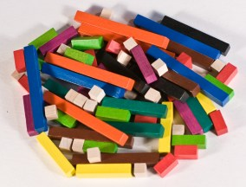

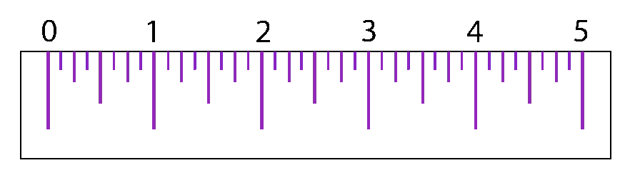
Times Tables You Must Know
The 1, 2, 5 and 10 times tables are the foundation facts. You must know them off by heart. You can learn them using dot patterns, Cuisenaire rods and number lines. All other times‑table facts can be worked out from these facts and from understanding that multiplication is commutative (you can swap the order of the numbers).
This Photo by Unknown Author is licensed under CC BY-SA
This Photo by Unknown Author is licensed under CC BY-NC-ND

Slide 5
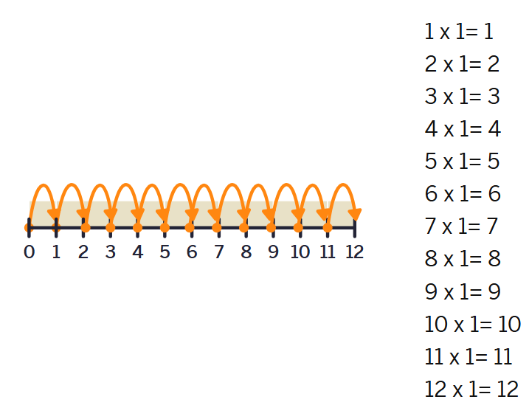

Times Tables You Must Know: One Times Tables
One Times Tables

Slide 6
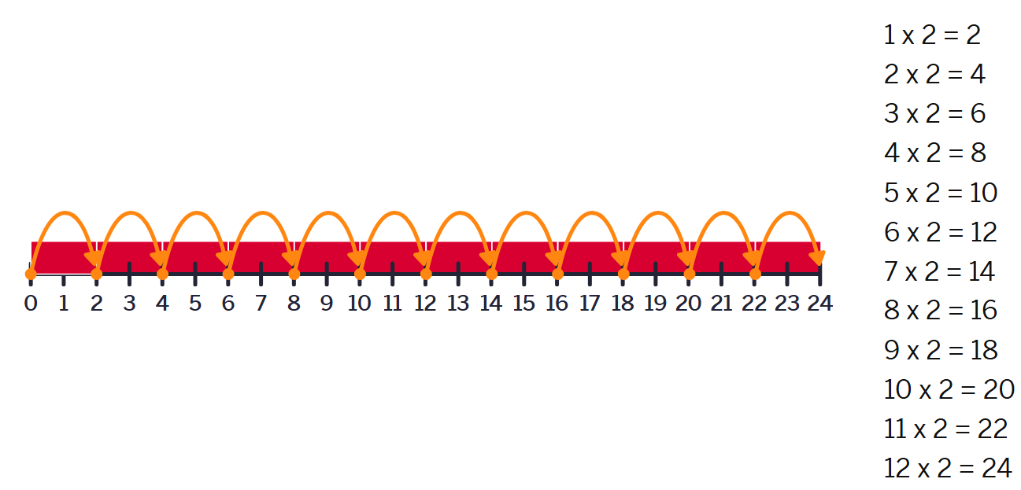

Times Tables You Must Know: Two Times Tables
Two Times Tables

Slide 7
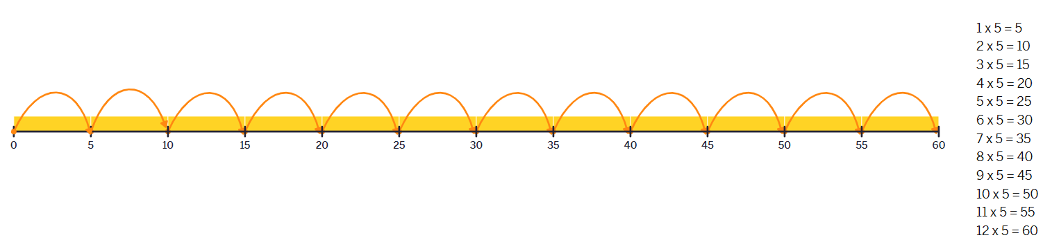

Times Tables You Must Know: Five Times Tables
Five Times Tables

Slide 8
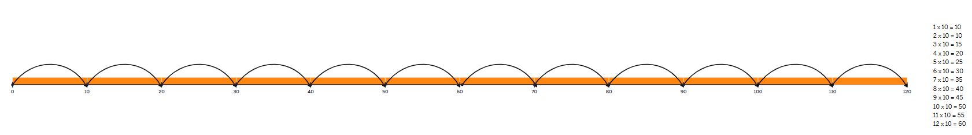
Times Tables You Must Know: Ten Times Tables
Ten Times Tables

Slide 9
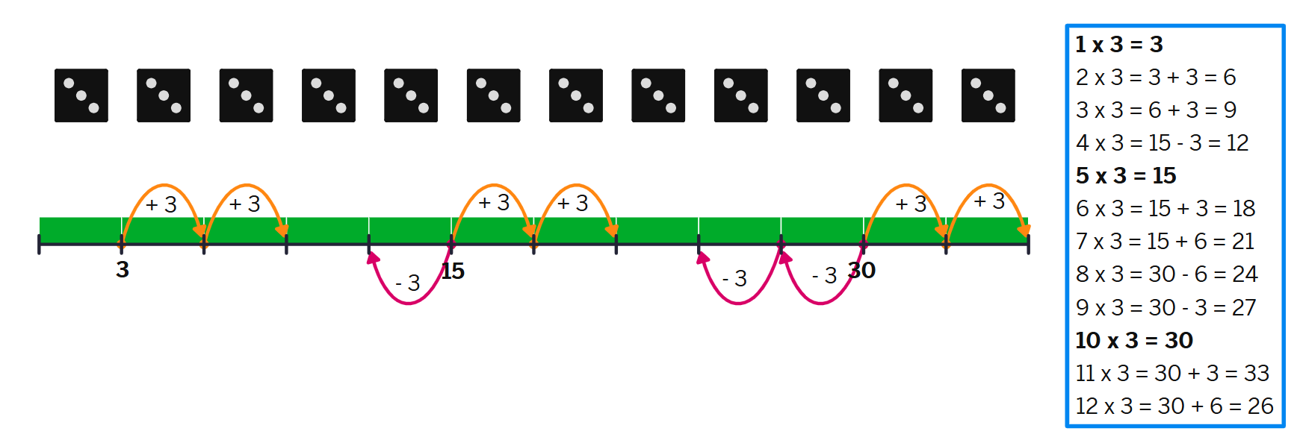

Working Out the Other Times Tables
All other multiplication facts can be reasoned from 1 x n, 5 x n, and 10 x n by adding or subtracting in small steps. Use flashcards to practice finding the closest anchor and reasoning forwards and backwards from there.
Reasoning patterns that derive all other tables
• 2 x n = (1 x n) + (1 x n)
• 3 x n = (2 x n) + (1 x n)
• 4 x n = (5 x n) - (1 x n)
• 6 x n = (5 x n) + (1 x n)
• 7 x n = (5 x n) + (2 x n)
• 8 x n = (10 x n) - (2 x n)
• 9 x n = (10 x n) - (1 x n)
• 11 x n = (10 x n) + (1 x n)
• 12 x n = (10 x n) + (2 x n)
Example: Three Times Tables

Slide 10
Drawing A Multiplication Square
Make good use of extra time in your maths exams by drawing a multiplication square. You can use it to solve multiplication and division problems and to identify square numbers and equivalent fractions.
To draw a multiplication square:
Draw the grid and label the rows and columns.
Fill in the parts you already know.
Begin with the multiplication tables you are most confident with, such as the 1s, 2s, 5s and 10s.
Then move on to the 9s, 11s and 12s, using the patterns in these tables to help you complete more of the grid.
After that, work through the 3s, 4s and 6s.
Leave the 7s and 8s until last, as these are often the trickiest.
Highlight the square numbers once the grid is complete.
Practise regularly until you can fill in the whole grid quickly and accurately.
x | 1 | 2 | 3 | 4 | 5 | 6 | 7 | 8 | 9 | 10 | 11 | 12
1
2
3
4
5
6
7
8
9
10
11
12

Slide 11
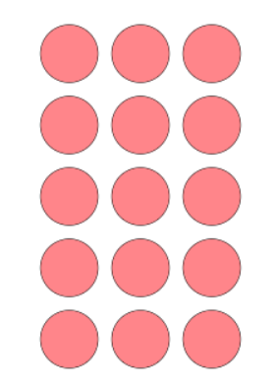
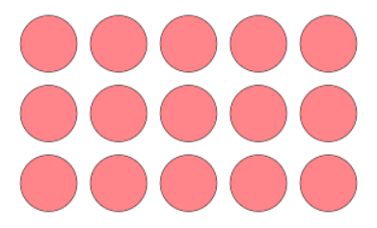
a x b = b x a
The commutative property of multiplication means that it doesn’t matter which way round you put the numbers when you multiply. The order can change, but the answer stays the same. For example, 3 x 5 and 5 x 3 both give the answer 15.
3 x 5 = 15
3 x 5 = 15
5 rows of 3 equals 15
5 x 3 = 15
3 rows of 5 equals 15
3 x 5 = 15

Slide 12
Acknowledgements
Images were created using free virtual manipulatives by Amplify available at Polypad.com.

